Slide 1
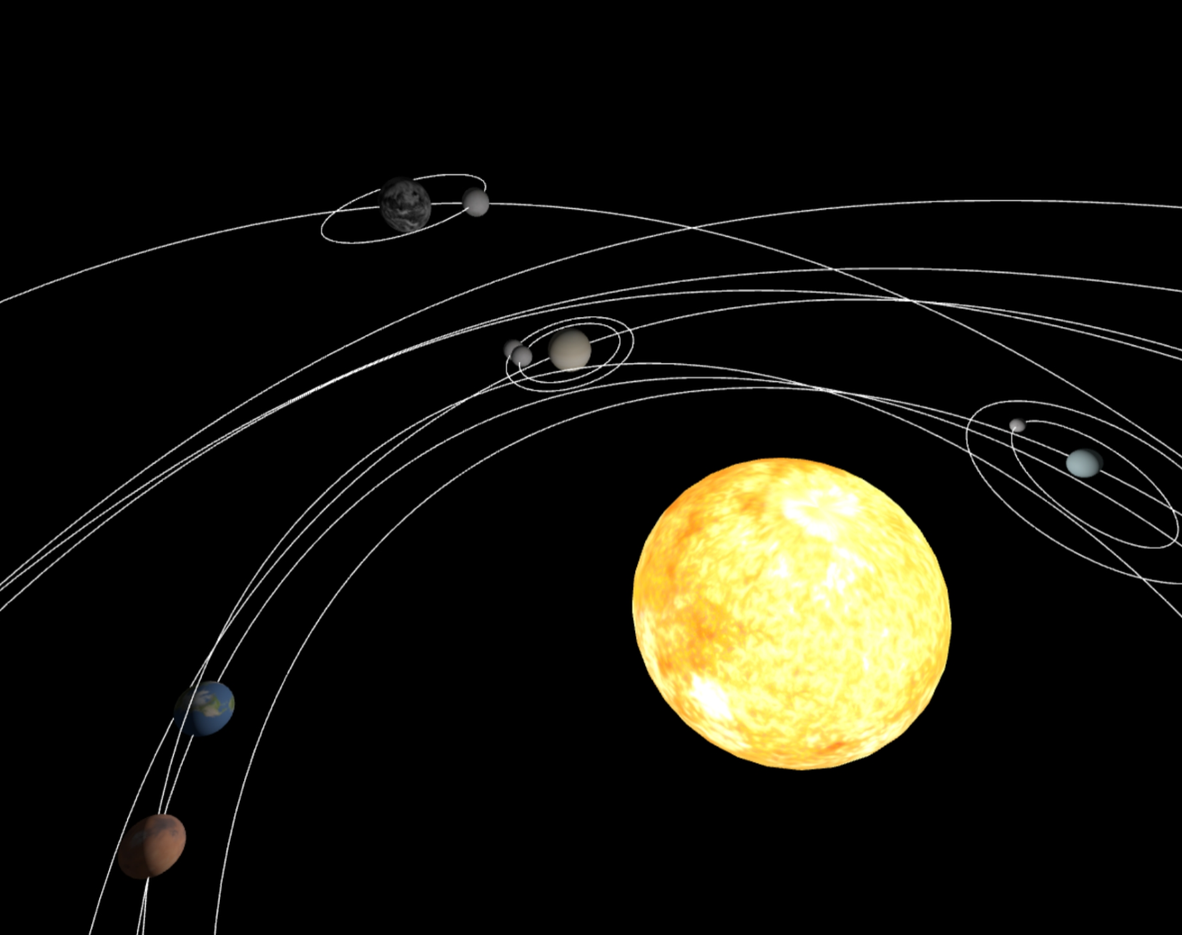
Solar Systems

Slide 2
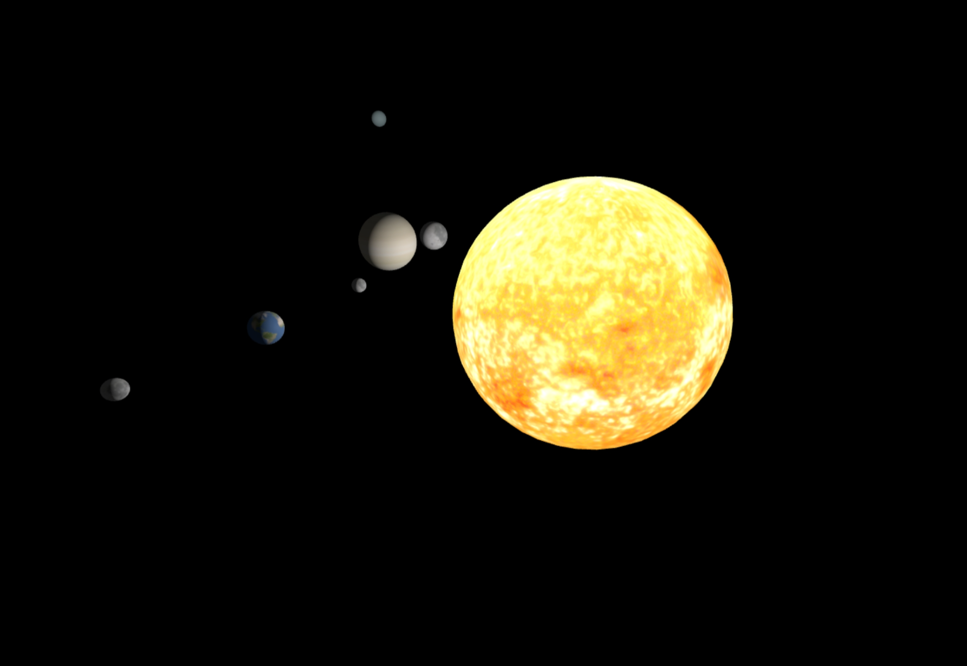

Main ideas
The project focuses on exploring various solar systems and being able to create their own.
What can the user do?
Navigate through the solar system;
Visualize the Celestial Bodies;
Download and Upload Solar Systems;
Toggle the orbits mesh;
Track his position using the mini map.
Available at https://www.solarsytems.pt/

Slide 3
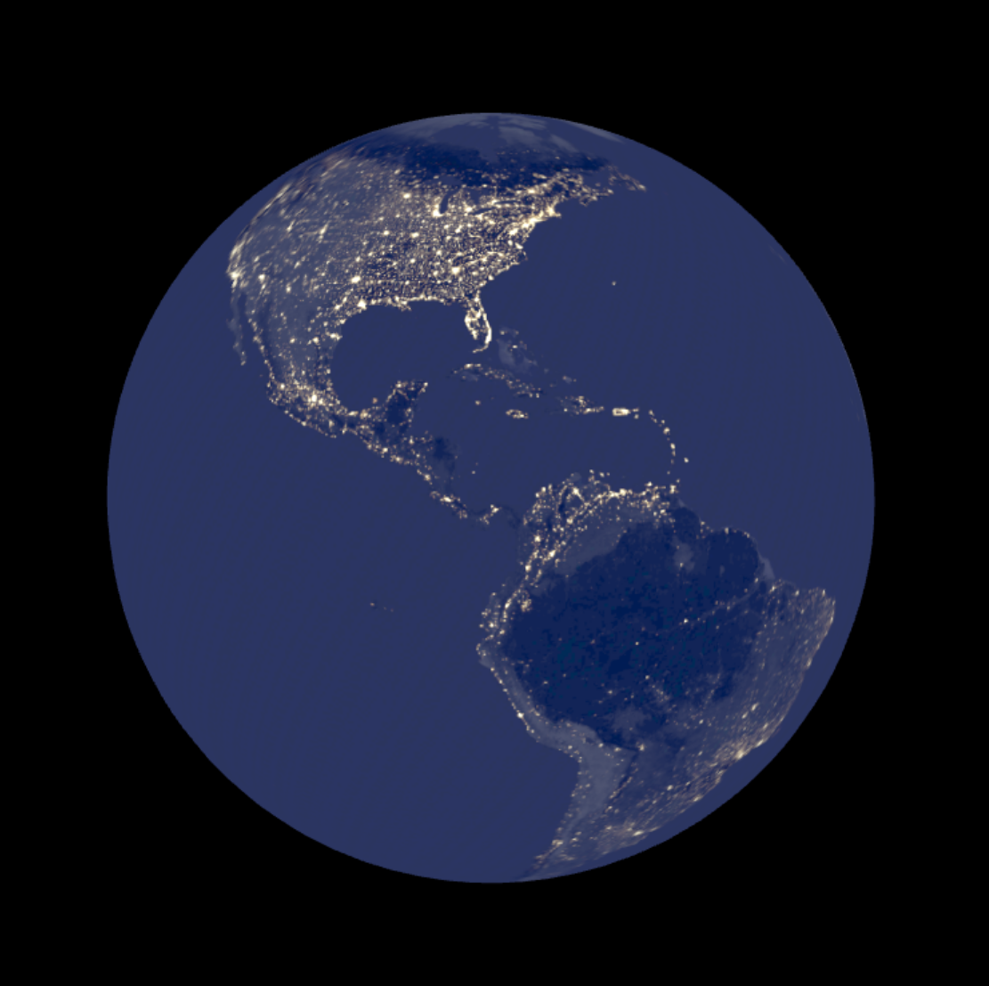
Models and the scene graph
SphereGeometry: Used to create the spherical shape for planets, moons, and stars.
Object3D: Used as a general-purpose object to group other objects, specifically for the Orbit class to hold the trajectory and for the Solar System to group all its celestial bodies.
BufferGeometry: Used in the Orbit class to create the trajectory line from a set of points.
LineLoop: Used in the Orbit class to draw the orbital path as a continuous loop.

Slide 4
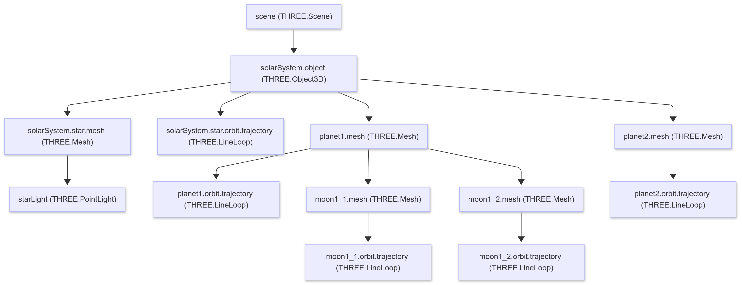
Scene Graph

Slide 5
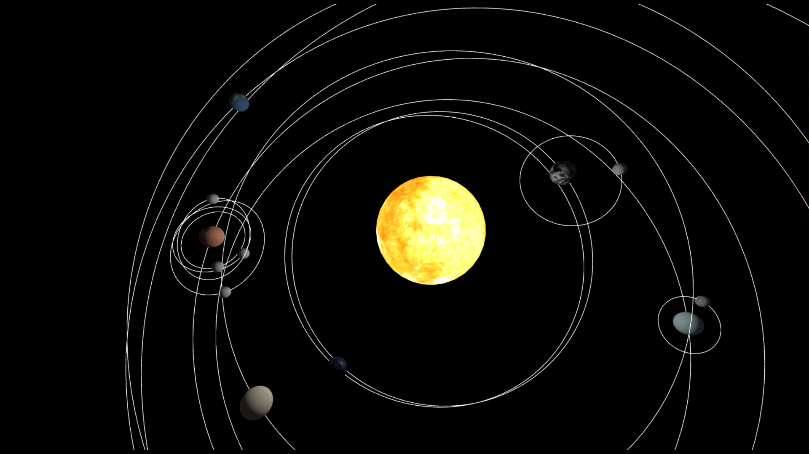
Animation
Celestial Body Movement (Rotation and Orbit)
Rotation: Each planet and moon spins on its axis by updating its rotation in the Y axis based on a calculate delta time (time since last frame) and its rotation speed
Orbit: Planets and moons orbit their respective centers (star for planets, planet for moons) by calculating a new elliptical position in each frame. This involves incrementing an orbit angle and applying the orbit’s radius, eccentricity and inclination to update its position

Slide 6
Animation
Camera Movement and Mini Map Updates
Player Movement: The main camera moves based on user input (WASD for horizontal, Space/Shift for vertical).
Minimap Camera Tracking: A separate mini map camera follows the main camera’s horizontal position and always looks straight down.
Minimap Camera Orientation
Minimap Zoom: Zoom level of the mini map can be smoothly adjusted with the mouse wheel.
Planet Info Cards: HTML cards for planets/moons appear only when within view and close enough. Their positions are updated in real-time using 3D-to-2D projection to stay aligned with their objects.

Slide 7
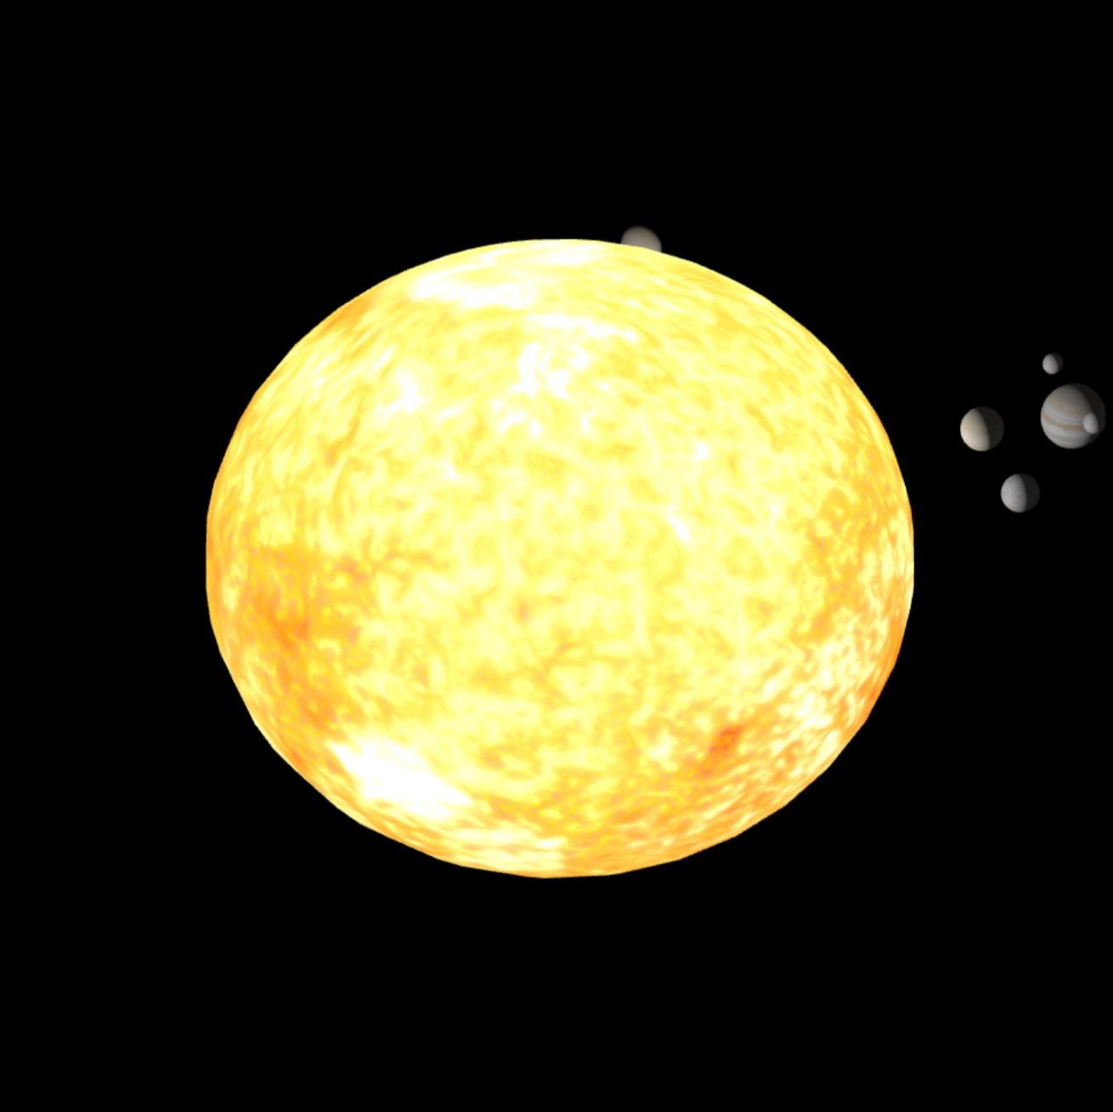
Illumination
Star Light (THREE.PointLight)
Main Light Source - A PointLight simulates the star (e.g., Sun), illuminating planets and moons with clear light and shadow effects.
Light Properties - Uses white light (0xFFFFFF) with high intensity (100) for strong illumination.
Dynamic Position - The light’s position updates to match the star mesh, ensuring accurate lighting origin.
Shadow Casting - Enables shadows from planets and moons; uses a 2048x2048 shadow map and adjusts shadow camera range based on the star’s radius.
Star Appearance - The star mesh uses Phong material with emissive properties and texture to appear self-illuminated and glowing.

Slide 8
Illumination
Ambient Light (THREE.AmbientLight)
Purpose - Provides soft, uniform fill lighting across the entire scene.
Light Properties - Uses a dark grey color (0x333333) with an intensity of 1.5 to prevent completely black shadows.
Effect - Adds subtle illumination to shadowed sides of planets and moons, maintaining visual detail even without direct star light.

Slide 9
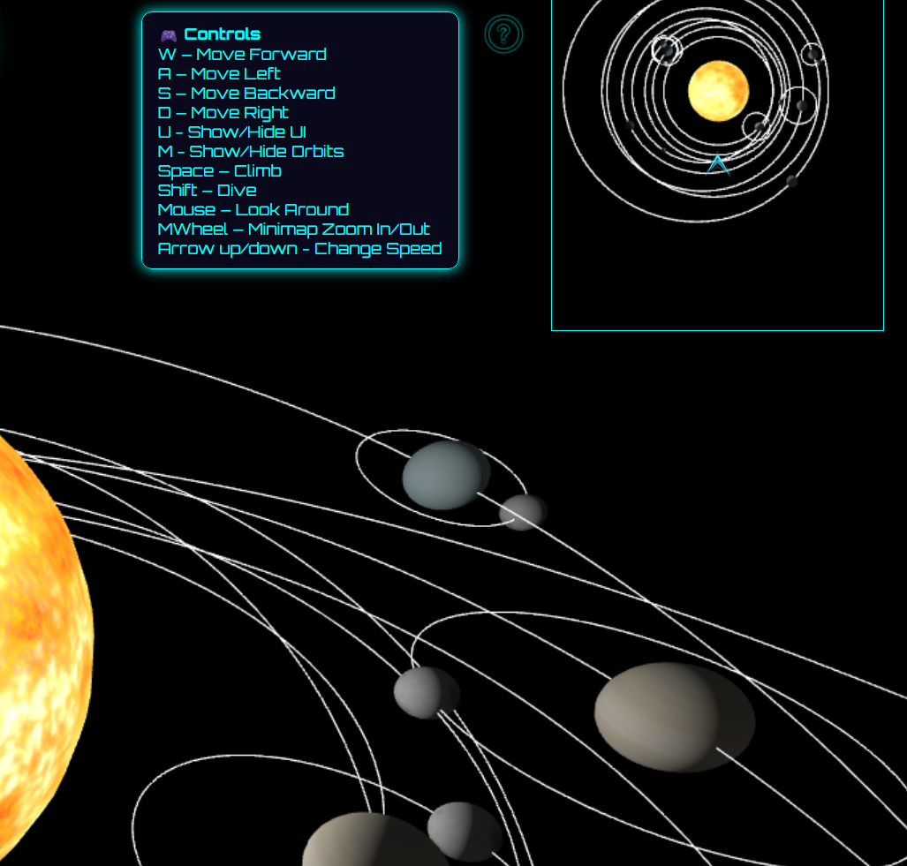
User Interaction
Action | Control
Move Forward | W
Move Backward | S
Move Left | A
Move Right | D
Show/Hide UI | U
Show/Hide Orbits | M
Move Up | Space
Move Down | Shift
Rotate Camera | Mouse Drag
Zoom In/Out Minimap | Scroll Wheel Up/Down
Increase/Decrease Orbit Speed | Up/Down Arrow

Slide 10
Development
Code organization & Implementation
Approach - Follows an object-oriented programming (OOP) structure to encapsulate logic for celestial bodies, movement, and rendering.
Structure - Code is modularized across multiple files for clarity and separation of concerns (e.g., planets, stars, utilities).
CI/CD - A DevOps pipeline is in place for continuous integration and deployment, streamlining updates and testing.
Challenges Faced
Eclipse Simulation - Accurately simulating eclipses (e.g., alignment and shadow casting) presented technical difficulties, particularly in ensuring realistic light/shadow behavior.

Slide 11
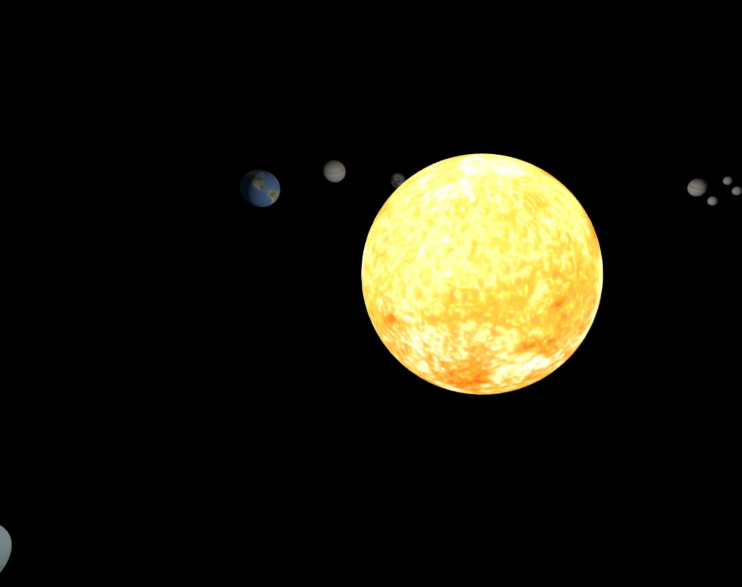
All the goals were achieved except for the eclipses…

